Slide 1

The Better India
World's largest positive & solutions-based content-driven impact platform
Created By:
SATENDRA SHRIVASTAVA

Slide 2
INTRODUCTION:
The Better India is a company that uses the power of digital media to tell uplifting stories of inspiring people and organizations in India. Its focus is on showcasing positive change, courage, and hope. It's aim to motivate our audience to turn this inspiration into real impact.
It is also partner with brands to run campaigns that make a meaningful difference on the ground. The better India mission is to promote constructive work in India and contribute to the overall advancement of positive impact.
http://www.thebetterindia.com

Slide 3
PROBLEM STATEMENTS:
Analyze the impact of demographics, spending behavior, and purchase history on customer acceptance and conversion rates to identify key factors contributing to campaign effectiveness.
Provide actionable insights to optimize marketing efforts, improve conversion rates, and enhance ROI through targeted segmentation, refined strategies, and personalized campaigns.
http://www.thebetterindia.com

Slide 4
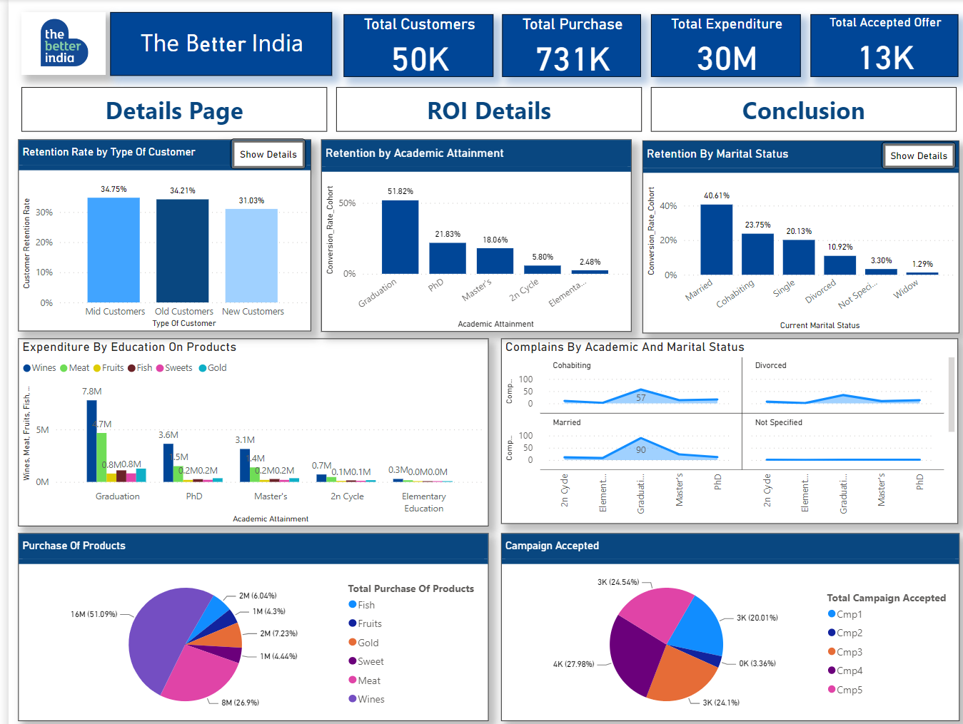
FINDINGS:

Slide 5
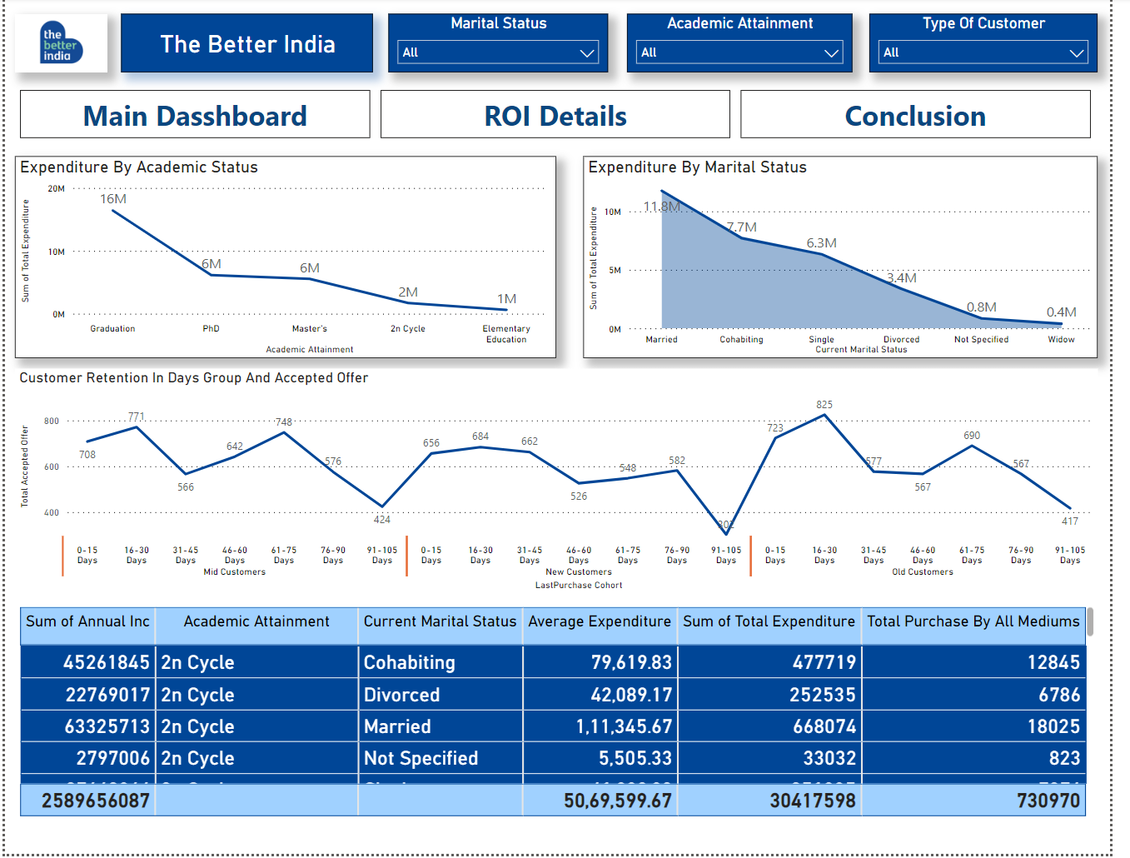
FINDINGS:

Slide 6
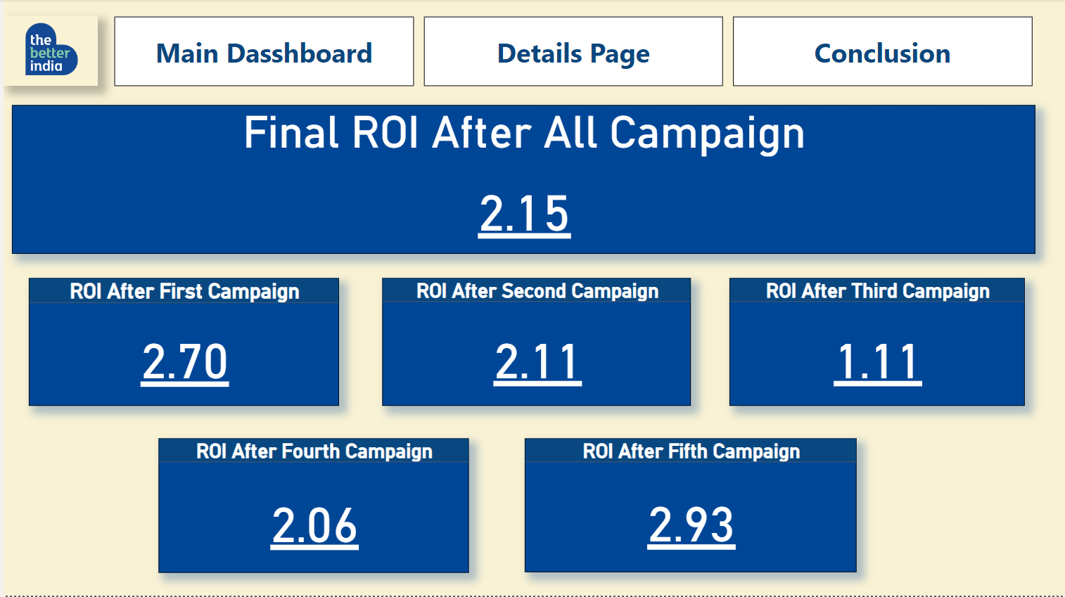
FINDINGS:

Slide 7
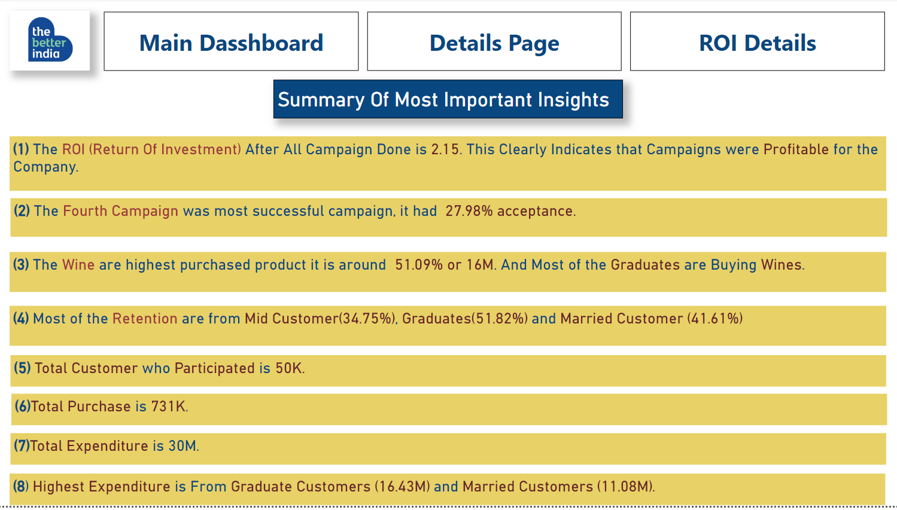
CONCLUSION:

Slide 8


